Slide 1
IOT Based Mobile Printer

Slide 2
Introduction
It is a mobile printer that runs across the paper and prints while doing so. The printer is small enough to fit on the palm, and yet can print on a paper of any size.
The printer is connected with a mobile or laptop using a WIFI module embedded into it and acquire the data that is to be printed.
A hassle free and wireless design which reduces the user complexity.

Slide 3
Why a Mobile Printer?
Printers are a necessity in every workplace. Every office or home that has a computer will need a printer. As we are using our tablets and smartphones more than ever, printers do not come in handy all the time.
With the introduction of a mobile printer, people can print anywhere at any time of the day.
Mobile printers can revolutionize the way people who work on the go solve their printing requirement. This will allow them to work on field and print important documents using mobile printers.
High efficiency, Connectivity and Portability makes our printer a one of its kind.

Slide 4
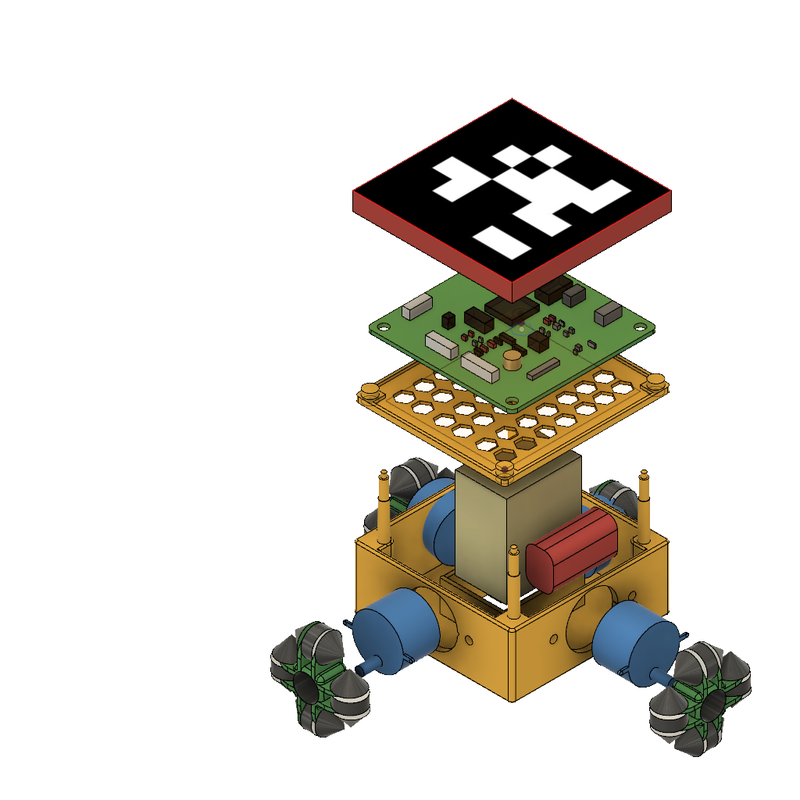
Construction
The Printer consists of three layers:
First Layer – It is the upper lid of the printer and covers the circuit board beneath it.
Second Layer – It holds the circuit board above the base.
Third Layer – It is the base layer which homes the cartridge, battery and the motors at each side of the base.

Slide 5
Working
The mobile printer receives the data from a host through Wi-Fi.
Upon receiving the data, the printer divides the total printing area for convenience and prints one area at a time.
The locomotion and ink spraying mechanism is controlled using the microcontroller unit.
Performance of the printer can be improved using optical tracking system using AprilTag fiducial markers.

Slide 6
Electronics
The main microcontroller of the printer is ESP8266.
ATmega328P is used as an auxiliary controller.
DRV8834 is used to drive the motors for locomotion.
3.7V Li-Po batteries are used in series to provide the input power supply.
A boost converter is employed to drive the inkjet cartridge.
RGB LED and switches provide user interface.

Slide 7
Communication
The communication of our printing robot is performed using the ESP8266 along with an auxillary ATmega328P microcontroller.
Communication is achieved using UDP protocol.
Both local and global communication is established through the ESP8266.
Local communication is used to transfer data between two local printers in case of multiple robots.
Global Communication is used to transfer data between a mobile printer and base station.

Slide 8
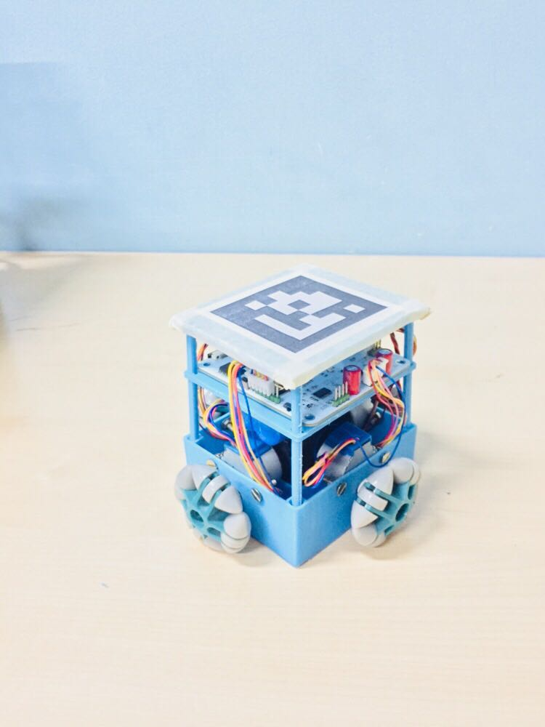
The Mobile Printer

